Slide 1
Simplification of NIHR Academy Programmes

Slide 2
Background
Since 2018, the NIHR Academy has been working to break down barriers to career progression in research
But our portfolio of opportunities has grown over the years and become complex
We want to simplify how these are presented to ensure the opportunities are more accessible and easier to understand
We don’t want, however, to lose the focus on areas we have worked hard to promote
We want to rationalise where there is commonality so that we can be more effective

Slide 3
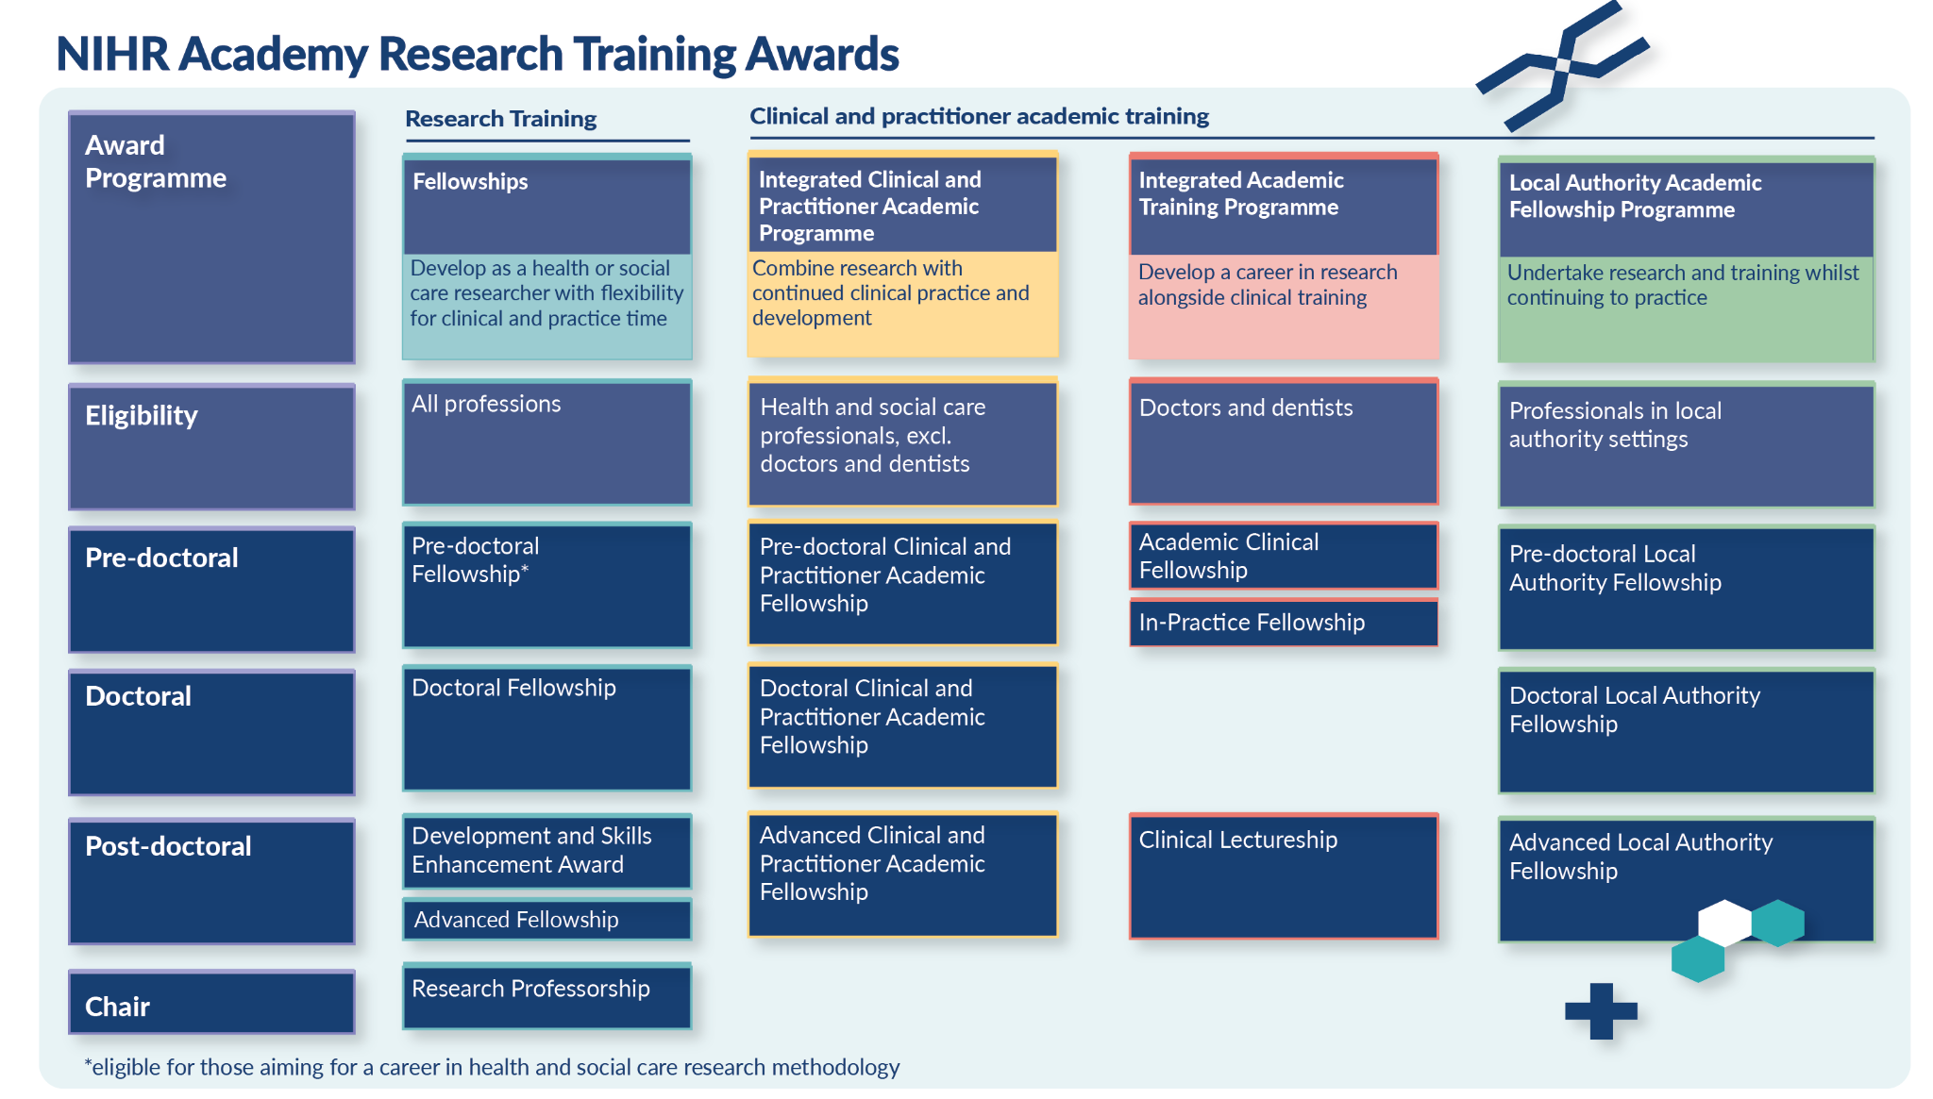
NIHR Academy Research Training Awards

Slide 4
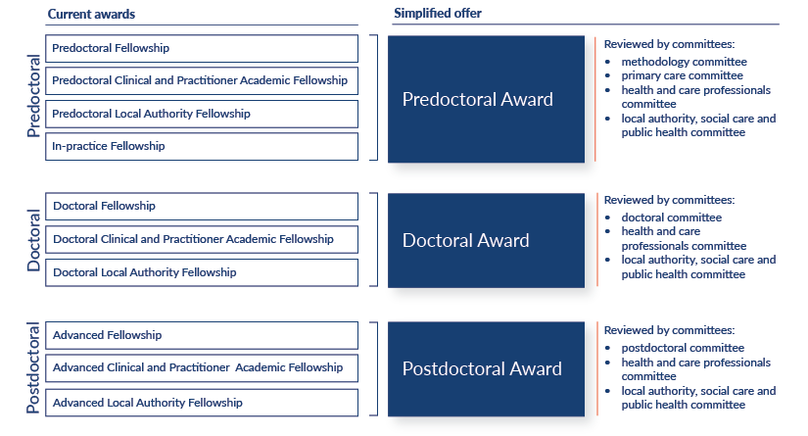
NIHR Academy simplified offering

Slide 5
What is changing?
In 2025 we will align awards from NIHR Fellowships, NIHR Integrated Clinical and Practitioner Academic (ICA) Fellowships and Local Authority Academic Fellowships (LAAF) programmes by career stage (predoctoral, doctoral and postdoctoral levels)
No funding opportunities will be lost and there is no reduction in investment
We will keep a focus on audiences in areas we have worked hard to promote
We will have committees at each level that are similar to our current committees and that will review applications based on applicants background, setting and area of research interest

Slide 6
What are the benefits?
Improved communication about our offer of career development awards, including language to describe our awards
Easier to navigate opportunities
Removal of duplication
Committees that assess applications are arranged based on research area, professional context and setting

Slide 7
NIHR Academy Career Development

Slide 8
When is it happening?
The new awards will launch in 2025:
Predoctoral Award 29 January - 20 March 2025
Postdoctoral Award 26 March - 21 May 2025
Doctoral Award 9 April - 10 June 2025
Doctoral and Postdoctoral awards will run twice a year
Further information will be published ahead of each simplified award launch

Slide 9
Sign up to our funding and support newsletter and follow us on social media to stay up-to-date
@NIHRresearch
NIHR-Community

